Slide 1
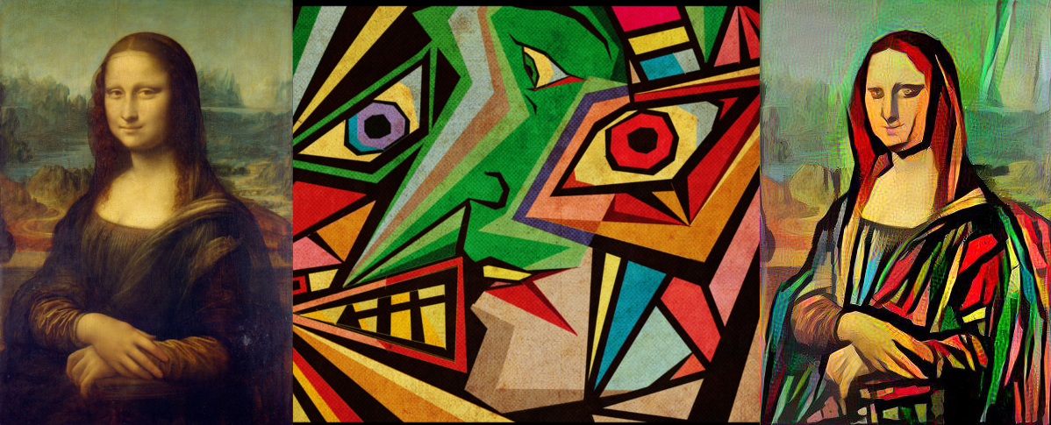
Extensions to
Neural Style Transfer
CSCI 566
Deep Learning and its Applications
Team : 4D Tensor
Praveen Iyer, Sneha Bandi, Swarnita Venkatraman, Neha Chawla

Slide 2
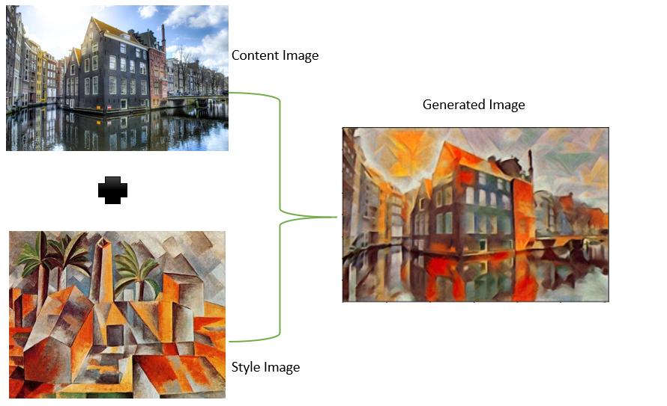
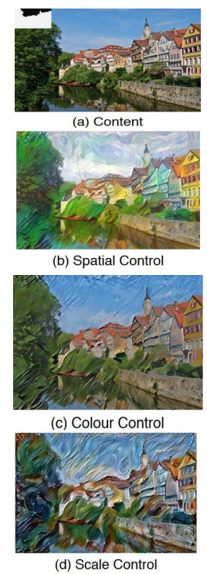
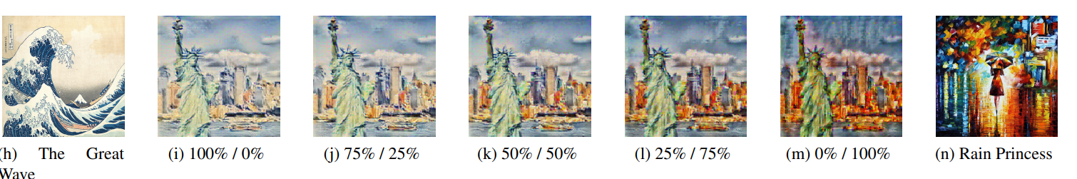
Aim
Existing Work
Key Insight
We propose extension to the original neural style transfer technique to enhance the final style of the output image.
There have been many successful implementations of NST in recent years.
In most works, stylization is confined to pixel domain and there could still be style distortions
Practically, users may not have exact image enhancements/ corrections in mind but may still be interested in enhancing their images.
Cascade Style Transfer can be used to combine multiple style images, alongside human observed heuristic knowledge to improve stylistic quality of generated image.
Content Image
+
Our Approach
User Feedback : Enhance the image style based on user preferences.
Cascade Style Transfer : To apply multiple styles to a single image.
Output Image
Style Image

